Slide 1
M4

Slide 2
Apart from causing sea breeze and land breeze, air also helps to form rain.

Slide 3

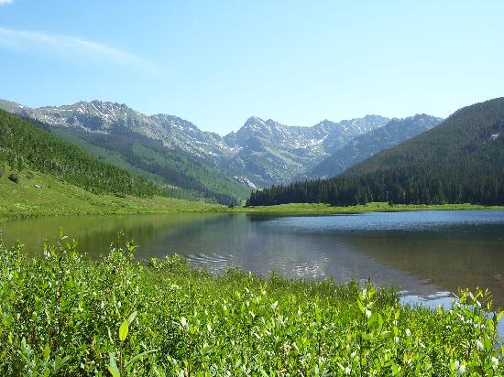


Rain
When water bodies are heated during the day water evaporates and goes into the air.
Also because of biological activity- water vapour goes into the air.
The air gets heated.
Hot air rises up carrying the water vapour with it.
As the air rises, it expands and cools.
This cooling causes the water vapour in air to condense in the form of tiny droplets.
Dust and other suspended particles in air help to form these droplets.
When the drops become big and heavy, they fall down in the form of rain.
Rainfall patterns are decided by wind patterns

Slide 4
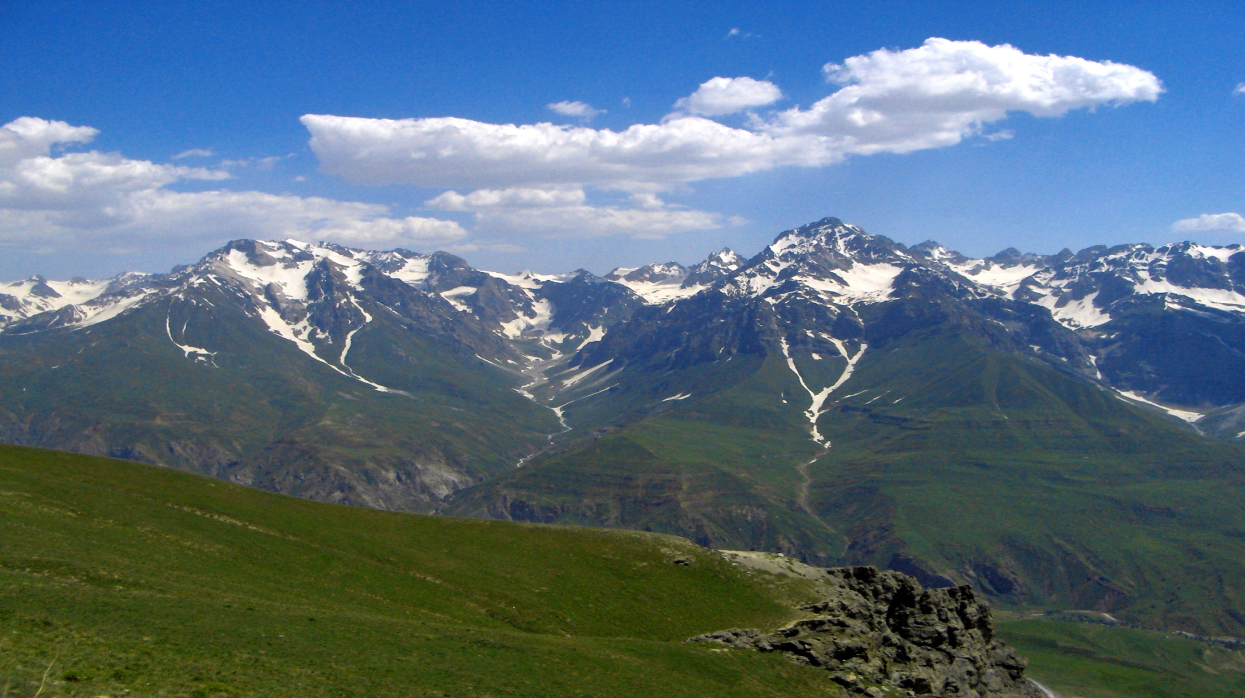



In India rains are mostly brought by southwest or north east monsoons.
North east
Southwest

Slide 5
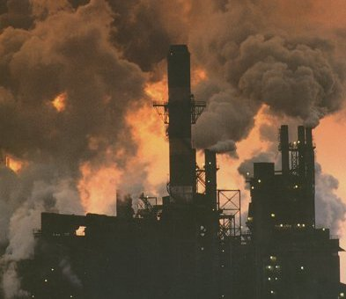
Air pollution
An increase in the content of harmful substances in the air is called air pollution.

Slide 6
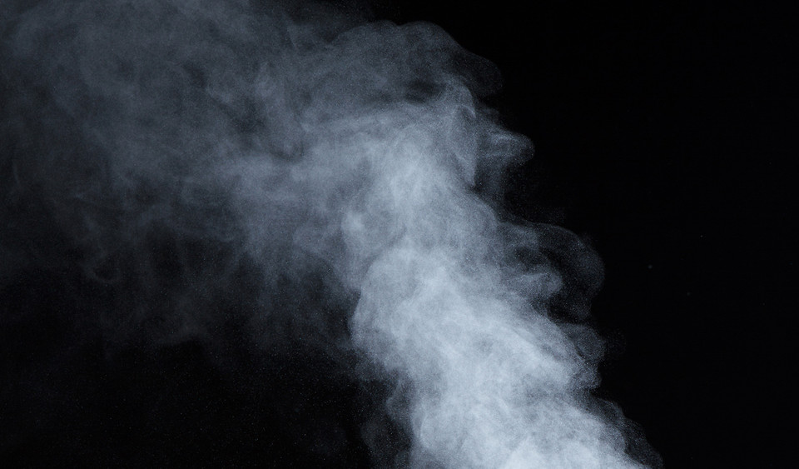
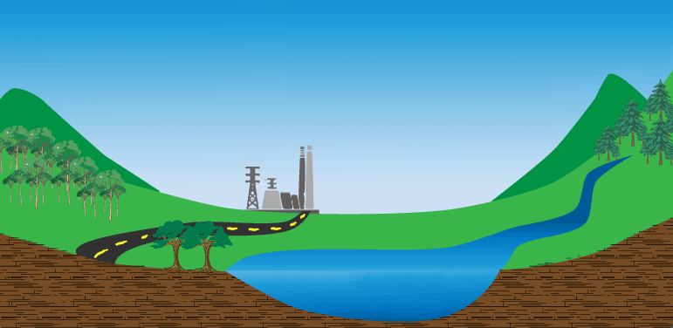
SO₂
NO₂
Acid rain
The fossil fuels like coal and petroleum contain small amounts of nitrogen and sulphur.
When these fuels are burnt, nitrogen and sulphur too are burnt and this produces different oxides of nitrogen and sulphur.
They dissolve in rain to give rise to acid rain.

Slide 7


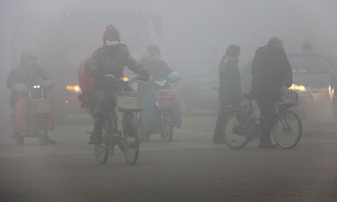
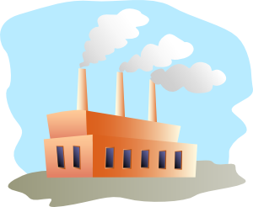
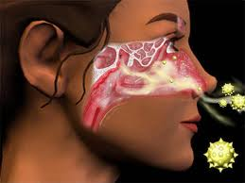
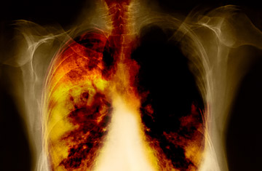
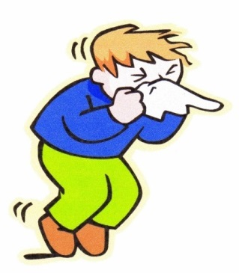

Smog
Mix with air
Suspended particles
The combustion of fossil fuels also increases the amount of suspended particles in air.
These suspended particles could be unburnt carbon particles or substances called hydrocarbons.
This is known as smog.
Effects of air pollution
Allergies
Cancer
Heart diseases

Slide 8
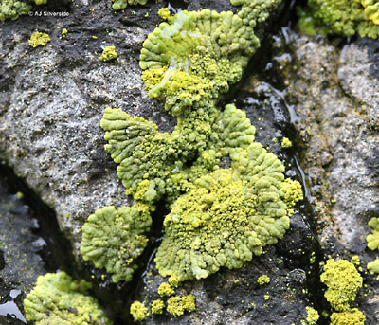
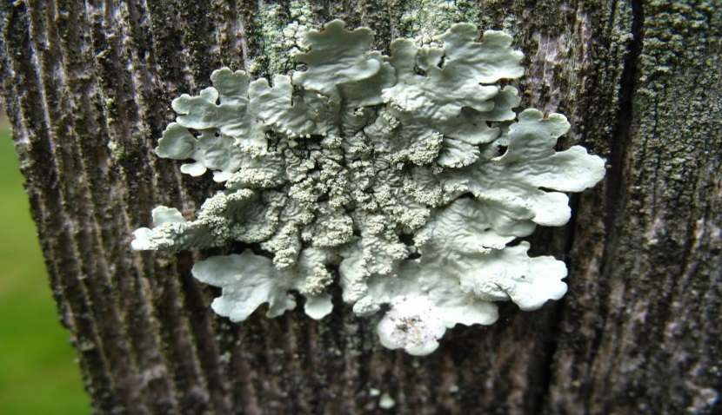
Lichens
Organisms called lichens are found to be very sensitive to the levels of contaminants like sulphur dioxide in air.
Lichens can be commonly found growing on the barks of trees as thin greenish-white crust.

